Slide 1

RUNGTA COLLEGE OF DENTAL SCIENCES AND RESEARCH
Endodontic instruments
DEPARTMENT OF CONSERVATIVE DENTISTRY AND ENDODONTICS

Slide 2
Specific learning Objectives
At the end of this presentation the learner is expected to know ;
Core areas* | Domain ** | Category #
History | Cognitive | Nice to know
Classification of endodontic instruments | Cognitive | Must know
Rubber dam | Cognitive | Must know

Slide 3
Content
Standardization of Instruments given by Ingle and Levine
Classification of Endodontic Instruments
Group I Hand-operated Instruments
Files
Group II Low Speed Instruments with Latch-Type Design
Group III Engine-Driven Instruments
Generations of NiTi Rotary Files
First Generation NiTi Rotary Files
Second Generation
Third Generation Files
Fourth Generation Reciprocating Instruments
Fifth Generation Instruments
Scout Race Files
Group IV Sonics and Ultrasonics in Endodontics
Sonic Handpiece
Instrument Deformation and Breakage
Instruments Used for Filling Root Canals

Slide 4
HISTORY
1746 − Fauchard developed one of the first instruments Similar to barbed broach, designed to remove pulp; without shaping the root canal
1808 − Ricci the dentist of His Royal Highness Duke of Benn and Edme Mary Miel used a little hand drill working with a chord of a bent bow to penetrate root canals, making holes of equal diameter along their length.
1820 − Maury developed another drill which could reach molars.
1858 − Maynard advocated pulp removal and became quiet an expert in filling premolar and molar canals with gold foil. He invented the Barbed Broach.
1852 − Dr. Robert Arthur of Baltimore, described how to make a fine pulp space file; provided guidelines for its mechanical properties.

Slide 5
1885- Gates–Glidden (GG) bur was invented
1889- Rollins introduced the first contra angle handpiece with specially
designed needles, which were mounted into a dental handpiece with a 360^{O} rotation. To avoid instrument fractures rotational speed was limited to 100 r.p.m.
1901-1905 − The K type instrument
designer Kerr Manufacturing company (Michigan, USA)
1915 − Kerr manufacturing Company patented all K-type instruments.
1930s Endo Cursor was designed
1957− Richman was first to use ultrasonics in endodontics.
1958 – Racer was introduced

Slide 6
1958 − Ingle and Levine first proposed standardization of endodontic instruments and suggested guidelines for the same.
1962 − The International Standards Organization (ISO) was formed, including American manufacturer’s and the American Association of Endodontists.
1963 – Beuhler et al developed Ni-Ti in Naval Ordinance Laboratory (NOL) in Silver Springs , Maryland.
1964 − The Giromatic, a quarter turn rotary reciprocating endodontic hand piece was introduced Roger Blank.
Endodontic handpieces such as the Endolift (Kerr, Germany) with a combined vertical and 90^{O} rotational motion and similar devices were marketed during this period
1976 − Martin and Cunningham were first to develop test and market an ultrasonic device for endodontics named Cavi-Endo system (Claulk / Dentsply)
1976 − Specification for endodontic instruments American National Standards Institute (ANSI) specification No. 28, was published.

Slide 7
1977 − Ben Johnson introduced Thermafil Gutta Percha obturation.
Early 1980’s − K-style endodontic instruments came into a series of modifications with hybrid designs.
1981 − The Flexoreamer and K-flexo file was produced by Maillefer in ISO sizes 15 to 40.
1982 − K-Flex file, A hybrid K-type instrument introduced by the Kerr manufacturing Co.
1984 − The Canal finder system that worked on a vertical stroke hand piece was developed in France.(first endodontic handpiece with a partially flexible motion)
1985 − This was followed by the introduction of the Flex –R-File designed by Roane, and developed by the union Broach Co. for use with balance force technique.
1988 −Harmeet Walia et al first reported the use of Nickel Titanium alloy for endodontic use.
1989 − Wildey and Senia designed an instrument based on K-type files with a short cutting segment known as canal master instruments (Brassler)
a modified version later as Canal Master U.

Slide 8
1992 − Herbert Schilder patented a new concept of instrument sizing with a constant percentile increase of 29.17% between successive instrument, which formed the basis of profile 29 series instruments and NiTi-Maillefer Profile Series.
1992 − Flexo-gates, a hand instrument designed for apical preparation was introduced by Maillefer .
1993 − The safety – H file a further modification of the H-file by Buchanan was introduced by the Kerr Manufacturing Company.
1993 − The improved form of canal master instrument was marketed as Canal Master Light Speed for use a slow speed handpiece.
Mid 1994 − Profile 29 series Greater Taper instruments were introduced.
1996 − Quantec Series 2000, rotary instruments (NTCo) made of Nickel Titanium with increases taper were developed to allow preparation of suitable tapered canals.
1997 − The Tri-auto ZX, which is a Cordless Engine driven pulp space preparation system, that electronically monitors the location of file tip and torque applied to the file, was introduced by J. Morita
360^{O}-rotation auto-reverse-mechanism & integrated electrical length determination

Slide 9
Since 1971 attempts have been made to use
Laser devices for root canal preparation and disinfection
Electro-physical devices have been described such as
Ionophoresis eg.(Endox, Lysis, Munich, Germany)
The Non-instrumental Technique (NIT) of Lussi et al. using a vacuum pump for cleaning and filling of root canals.

Slide 10
CLASSIFICATION OF ENDODONTIC INSTRUMENTS
Classification According to Function (Grossman’s Classification)
ISO Classification of Endodontic Instruments.
F.G. Harty’s Classification

Slide 11
GROSSMAN’S CLASSIFICATION
FUNCTION | INSTRUMENTS
Exploring | Smooth Broaches and Endodontic Fine Explorers (Used to locate canal orifice and to determine the direction and patency of root canal)
Debriding | Barbed Broaches (Used to extirpate the pulp and to remove devices and other foreign materials)
Shaping | Reamers and files (Used to shape the canal space laterally and apically )
Obturating | Pluggers, spreaders and LentuloSpirals (to place sealer and pack guttapercha points into the canal space)

Slide 12
ISO AND FDI CLASSFICATION OF ENDODONTIC INSTRUMENTS:
GROUPS | TYPES OF INSTRUMENTS
I II III IV | Endodontic instruments for hand use only. Engine driven instruments. Handle has been replaced by a latch type adaptor for insertion in contra angle hand piece. Endodontic engine driven instruments fabricated from a single metal latch and shaft and operative head, all compound of a single piece. Endodontic points.

Slide 13
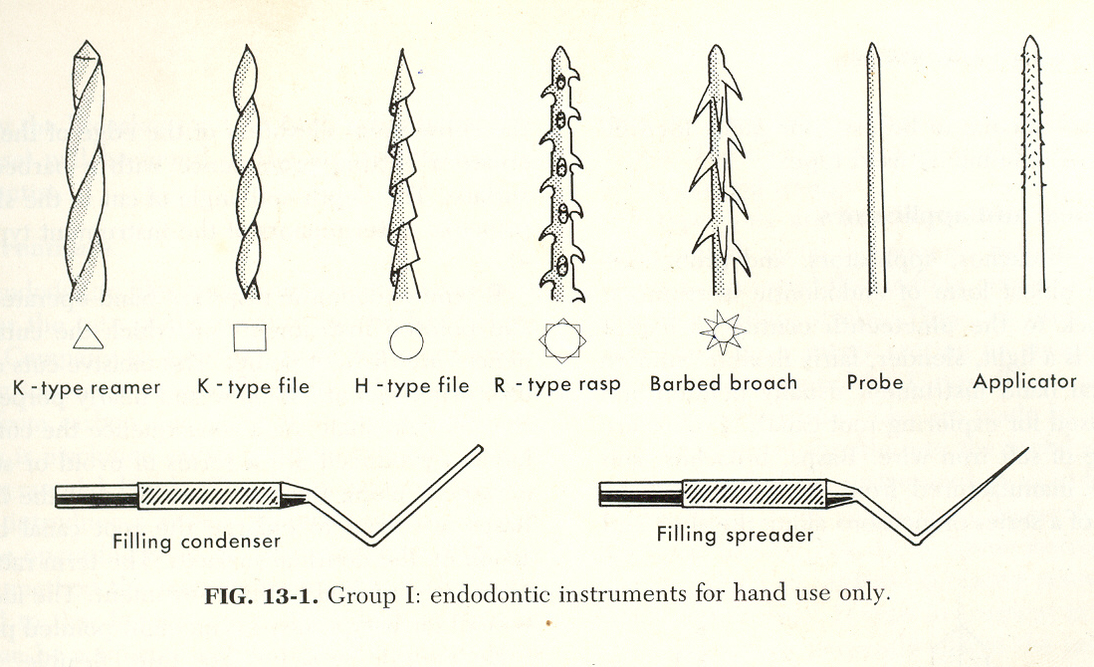
Group I

Slide 14
Group II
K- reamer
Lentulospiral

Slide 15
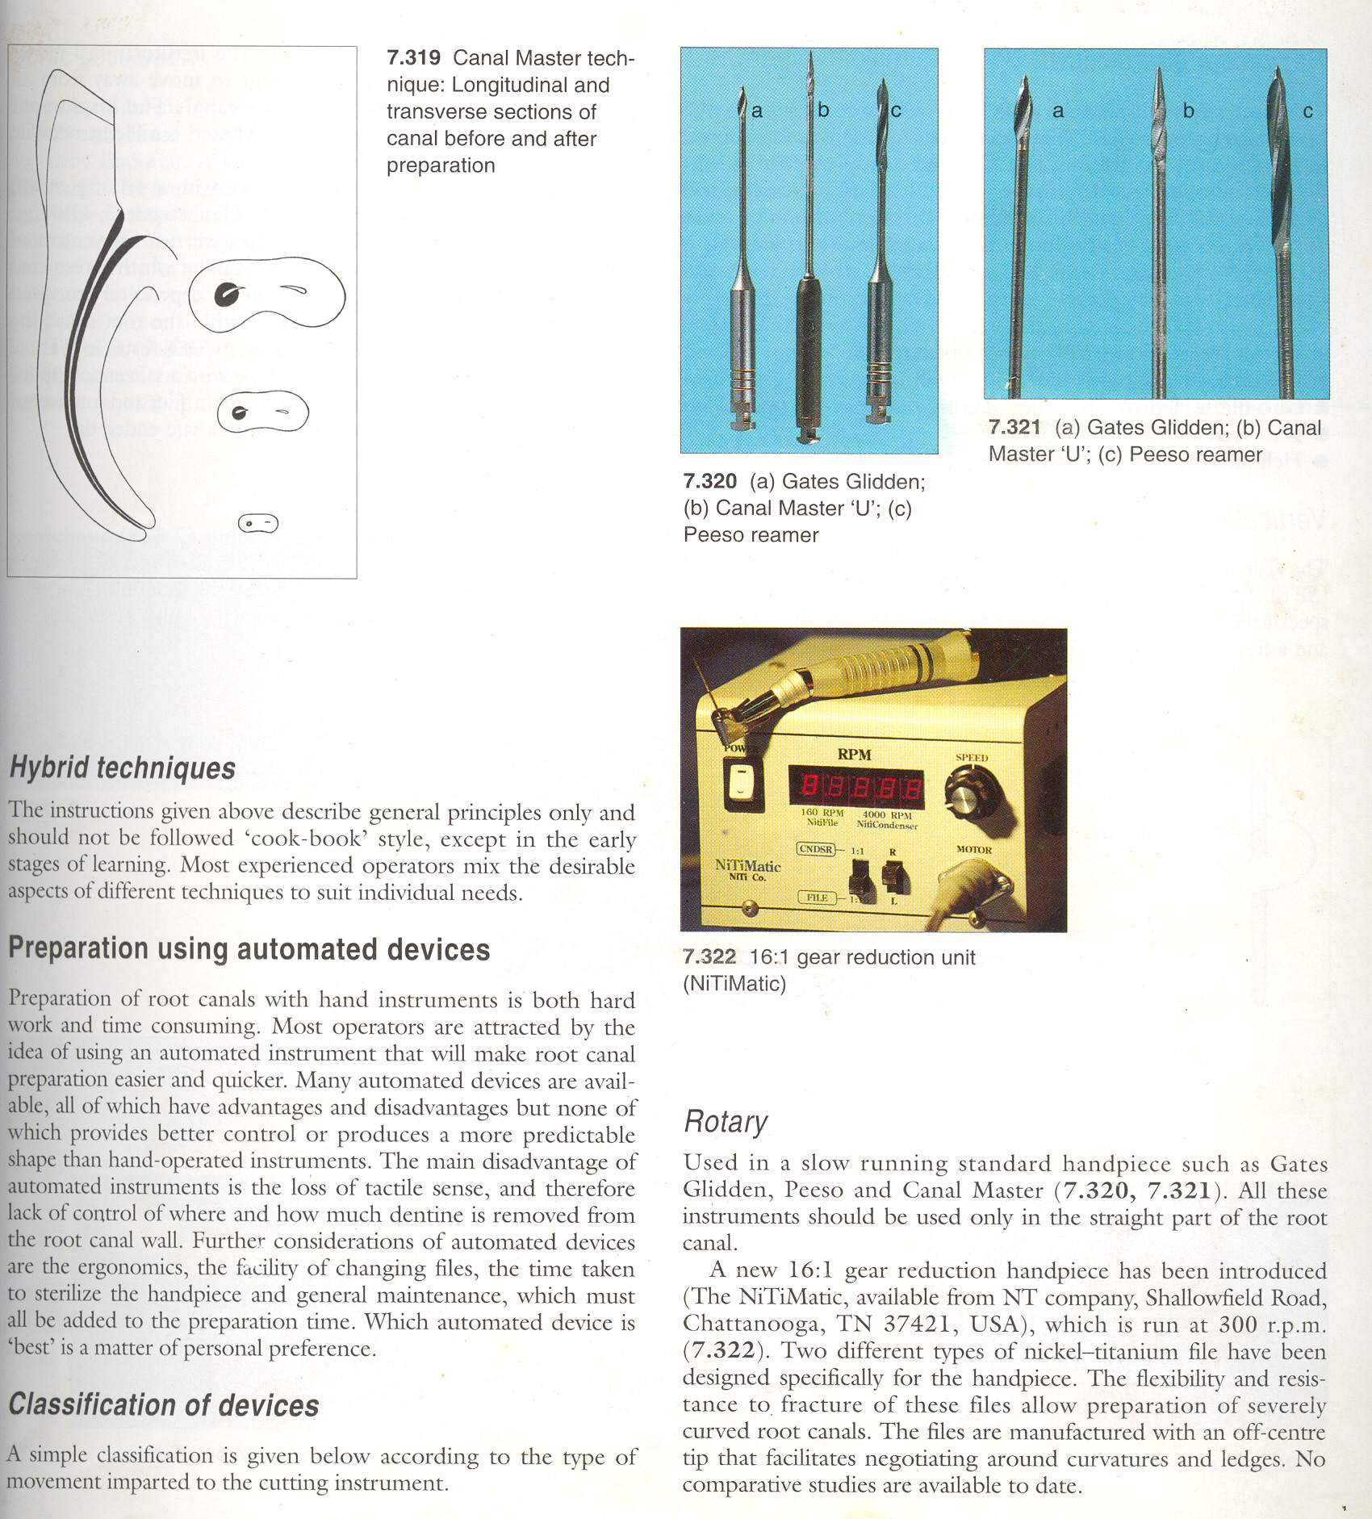
Group III
Peeso reamers
Gates- Glidden drills

Slide 16
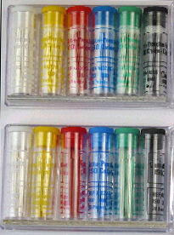
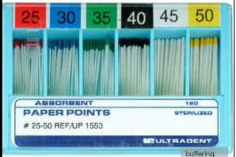
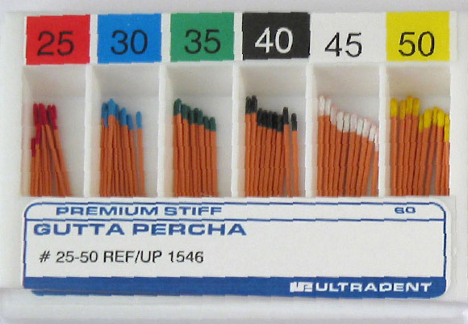
Group IV
Paper Points
Gutta Percha Points

Slide 17
F.G. HARTY’S CLASSIFICIATION:
1 | Hand instruments | (1) Barbed and smooth broaches (2) Reamers (3) Files – K. Type, H. type, Modified / Hybrid designs.
2 | Power assisted instruments for use. | Conventional rotary hand piece Burs Reamers Leutulo-spirals (2) Reciprocating handpieces. (3) Ultrasonic and sonic techniques (4) SET canal finder system
3 | Equipments for storage and sterilization
4 | Standardized instruments

Slide 18
ANSI | GENERAL DESCRIPTION | ISO / FDI
28 58 63 71 78 | Root Canal Files (K-type) Hedstroem Files (H-type) Barbed Broaches and Rasps Root canal Enlargers Condensers, Pluggers, Spreaders Obturating Points | 3630/1 3630/1 3630/1 3630/2 3630/3 6877/

Slide 19
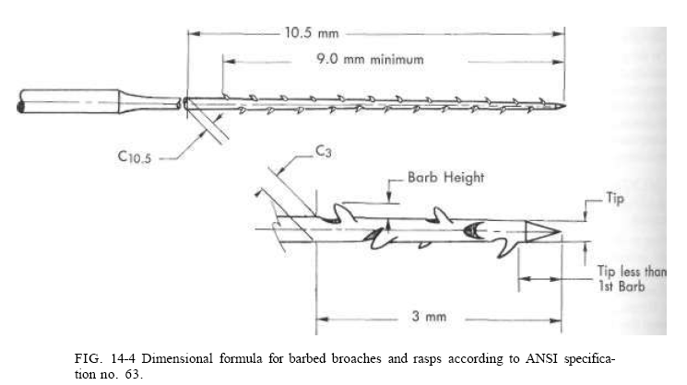
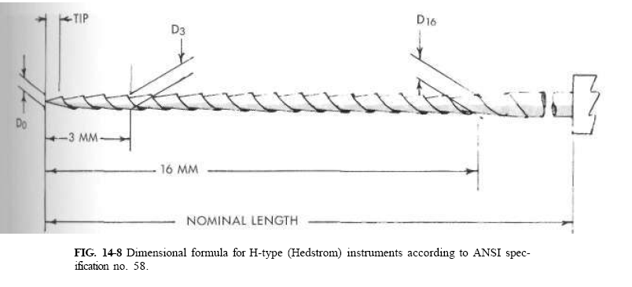

Slide 20
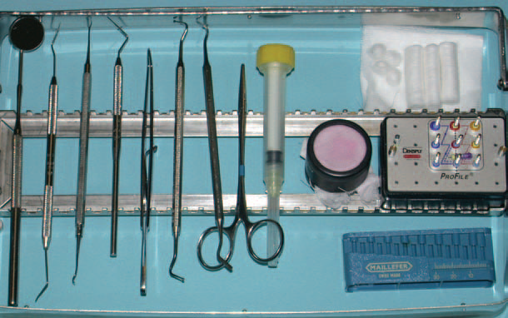
TYPICAL TRAY SETUP FOR ENDODONTIC USE
Mirror
Explorer
Endodontic Explorer
Locking Tweezers
Plastic Instrument
Needle Syringe
Endodontic Files
Cotton Rolls
EndoSponge
EndoBloc

Slide 21
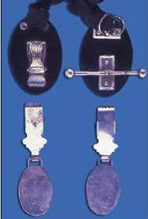
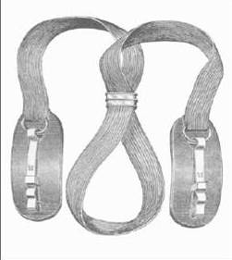
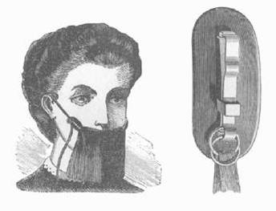
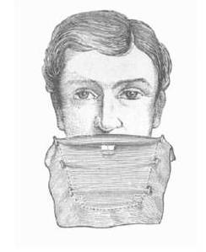
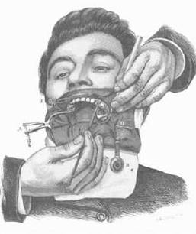
RUBBER DAM HISTORY
ISOLATION
B. Dr. Cogswell’s dam holder
A. Woodburg’s rubber-dam tensors
Dr. Fernald’s dam holders
Dr. Brasseur’s dam holder

Slide 22
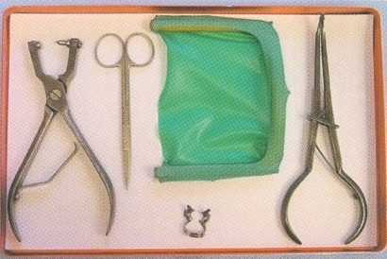
RUBBER DAM KIT
Kit Contents:
Rubber Dam Sheet
Rubber Dam Template
Rubber Dam Napkin
Rubber Dam Frame
Rubber Dam Punch
Clamp Holding Forceps
Scissors
Caulking Agent
Wedgets

Slide 23
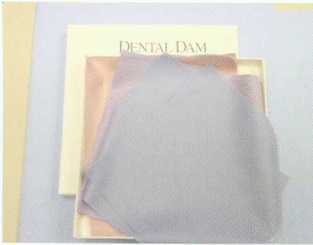
RUBBER DAM SHEETS

Slide 24
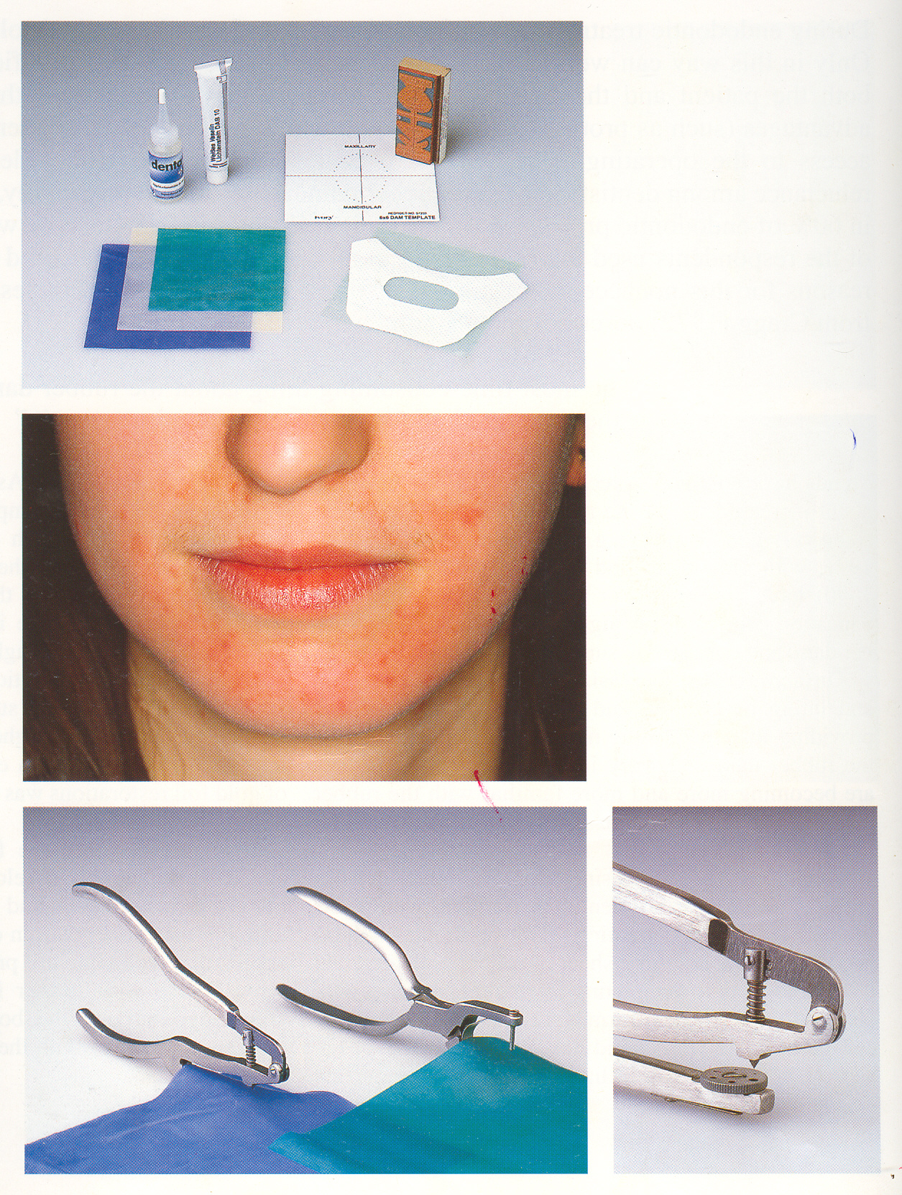
RUBBER DAM SHEETS
Thickness
Thin
0.005 – 0.007 inches
Is used most often for endo applications
Is easier to apply
Tears most readily
Does not seal the tooth well
Medium
0.007 – 0.009 inches
Most often used
For general all around use
Ease of manipulation

Slide 25
RUBBER DAM SHEETS
Heavy
0.009 – 0.0115 inches
Harder to tear
aids in soft tissue retraction
Extra heavy
0.0115 – 0.0135 inches
Maximum tissue retraction
Least likely to tear
Special heavy
0.0135 – 0.0155 inches
Used only in special situations where tissue protection is needed

Slide 26
RUBBER DAM SHEETS
Sizes
Precut sheets
5 inches ×5 inches (for pedodontic cases)
5 inches ×6 inches
6 inches ×6 inches (for all purpose)
Rubber dam is available in
Latex
Nonlatex Material
For patients who may have an allergy to latex
latex-free dams, such as silicone rubber

Slide 27
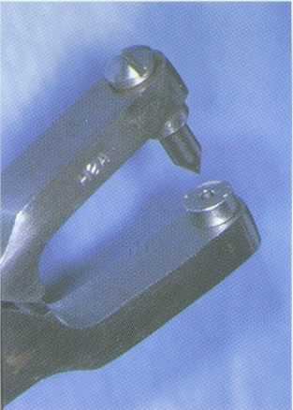
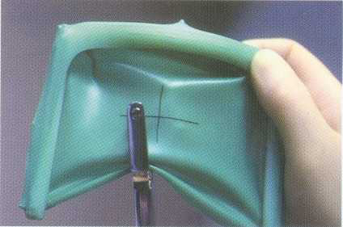
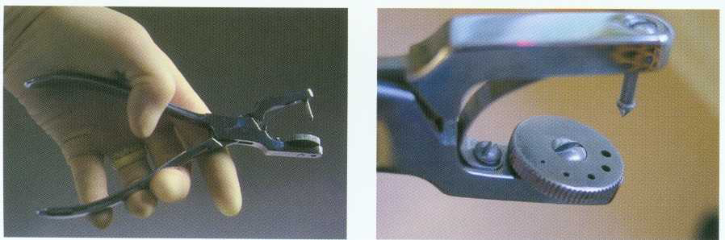
RUBBER DAM PUNCH

Slide 28
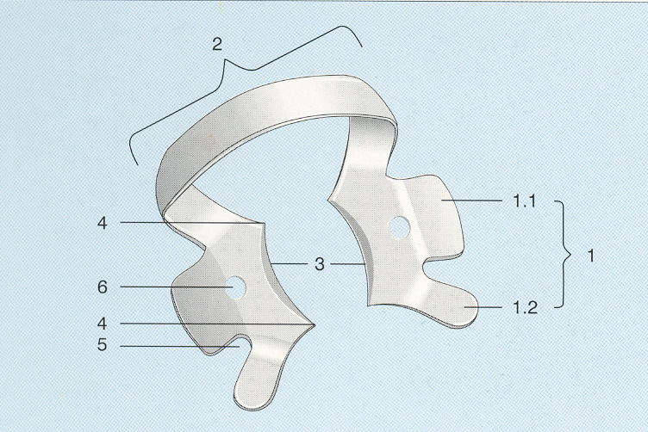
RUBBER DAM CLAMP
RUBBER DAM CLAMP
1) Clamp arm (lingual and buccal) with
1.1 central wing
1.2 anterior wing
2) Bow (distal)
3) Jaws
4) Contact point or prongs
5) Notch
6) Perforation

Slide 29
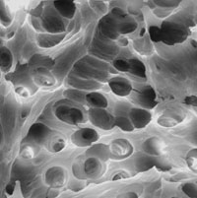
TAKE HOME MESSAGE
From a biological perspective, root canal treatment is directed toward the elimination of micro-organisms from the root canal system and the prevention of reinfection.
Technological advances in the form of rotary NiTi instruments have led to dramatic improvements in the ability to shape root canals with potentially fewer procedural complications.

Slide 30
QUESTIONS
What are various classifications of endodontic instruments?
What are components of rubber dam kit?

Slide 31
REFERENCES
Endodontic Practice 11th Edn. Grossman
Pathways Of The Pulp 6th Edn. & 9th Edn. Cohen
Endodontics Vol 1 Arnaldo Castellucci
Endodontics Ingle 5th Edn.
Text book of Endodontology Bergenholtz Reitz
Endodontic Therapy Weine 5th Edition
Color atlas of Endodontics William Johnson
Principles and practice of Endodontics- Walton &Torabinejad
Color Atlas of Microsurgery in Endodontics Syngcuk Kim
Textbook of Endodontics Nisha Garg Amit Garg

Slide 32
THANKYOU

